Slide 1
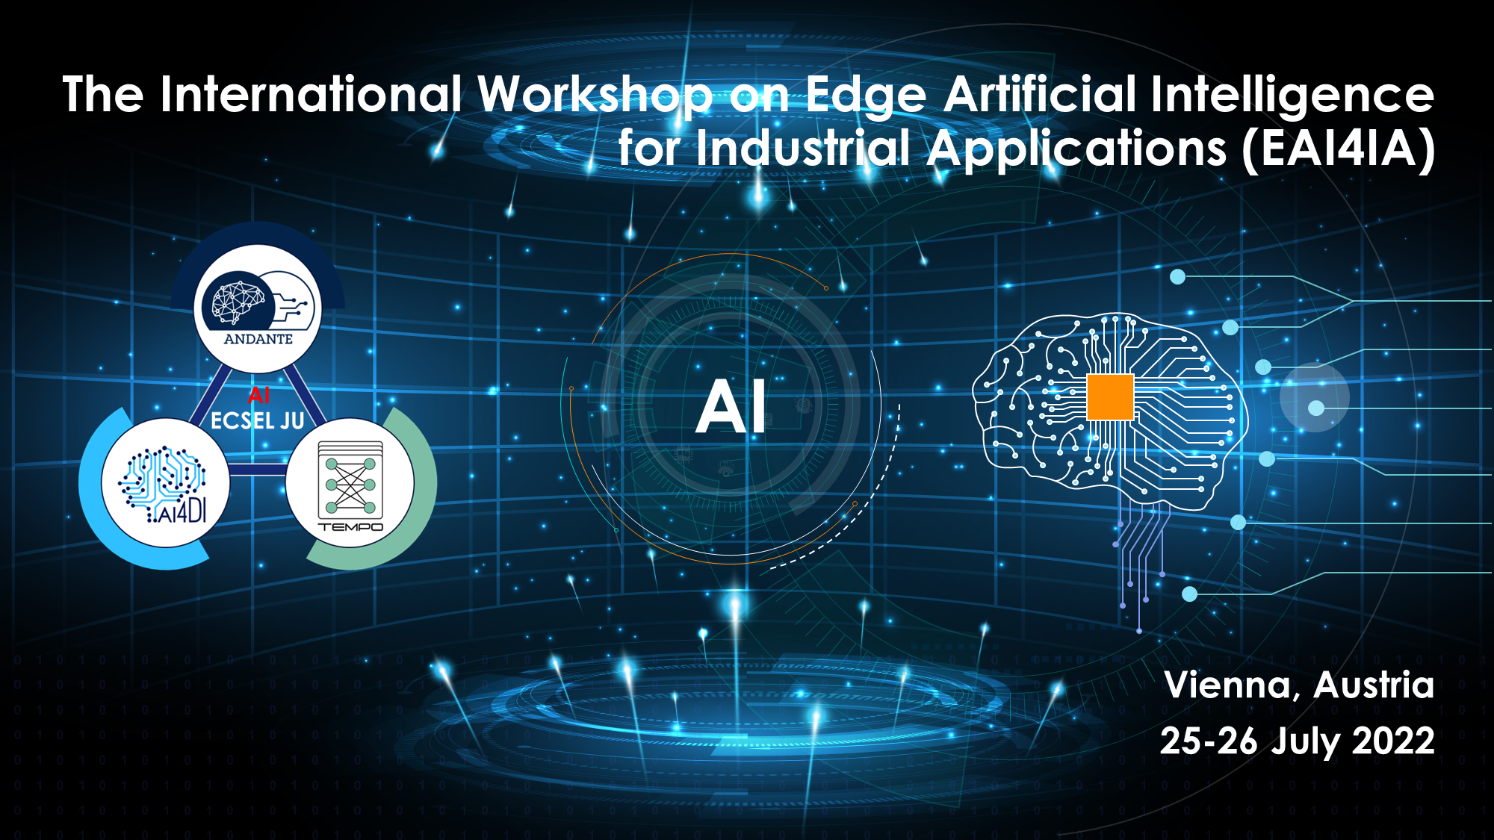

Slide 2
A framework for integrating automated diagnosis into simulation
David Kaufmann, MSc TU Graz, Austria
Prof. DI Dr. Franz Wotawa TU Graz, Austria

Slide 3
Presentation Outline
Introduction
Framework Design and Method Implementation
Use Case
CPS Simulation Model
ASP Diagnose Model
Demonstration
Conclusions

Slide 4
Introduction
How to prevent a systems from breaking?
Regular maintenance
Lifetime predictions
Diagnosis during runtime
Why performing advanced diagnosis on cyber-physical-systems?
Detection of failures during runtime
Localization of root cause
Initiating repair actions
Keep the system operational under safe conditions

Slide 5
Introduction
Requirements for testing and validation of an advanced diagnosis method:
Co-simulation environment framework
Standardized simulation environment
Step-by-step simulation
Fault injection during runtime
Interface for information flow to and from the method under test
Different programming environments

Slide 6
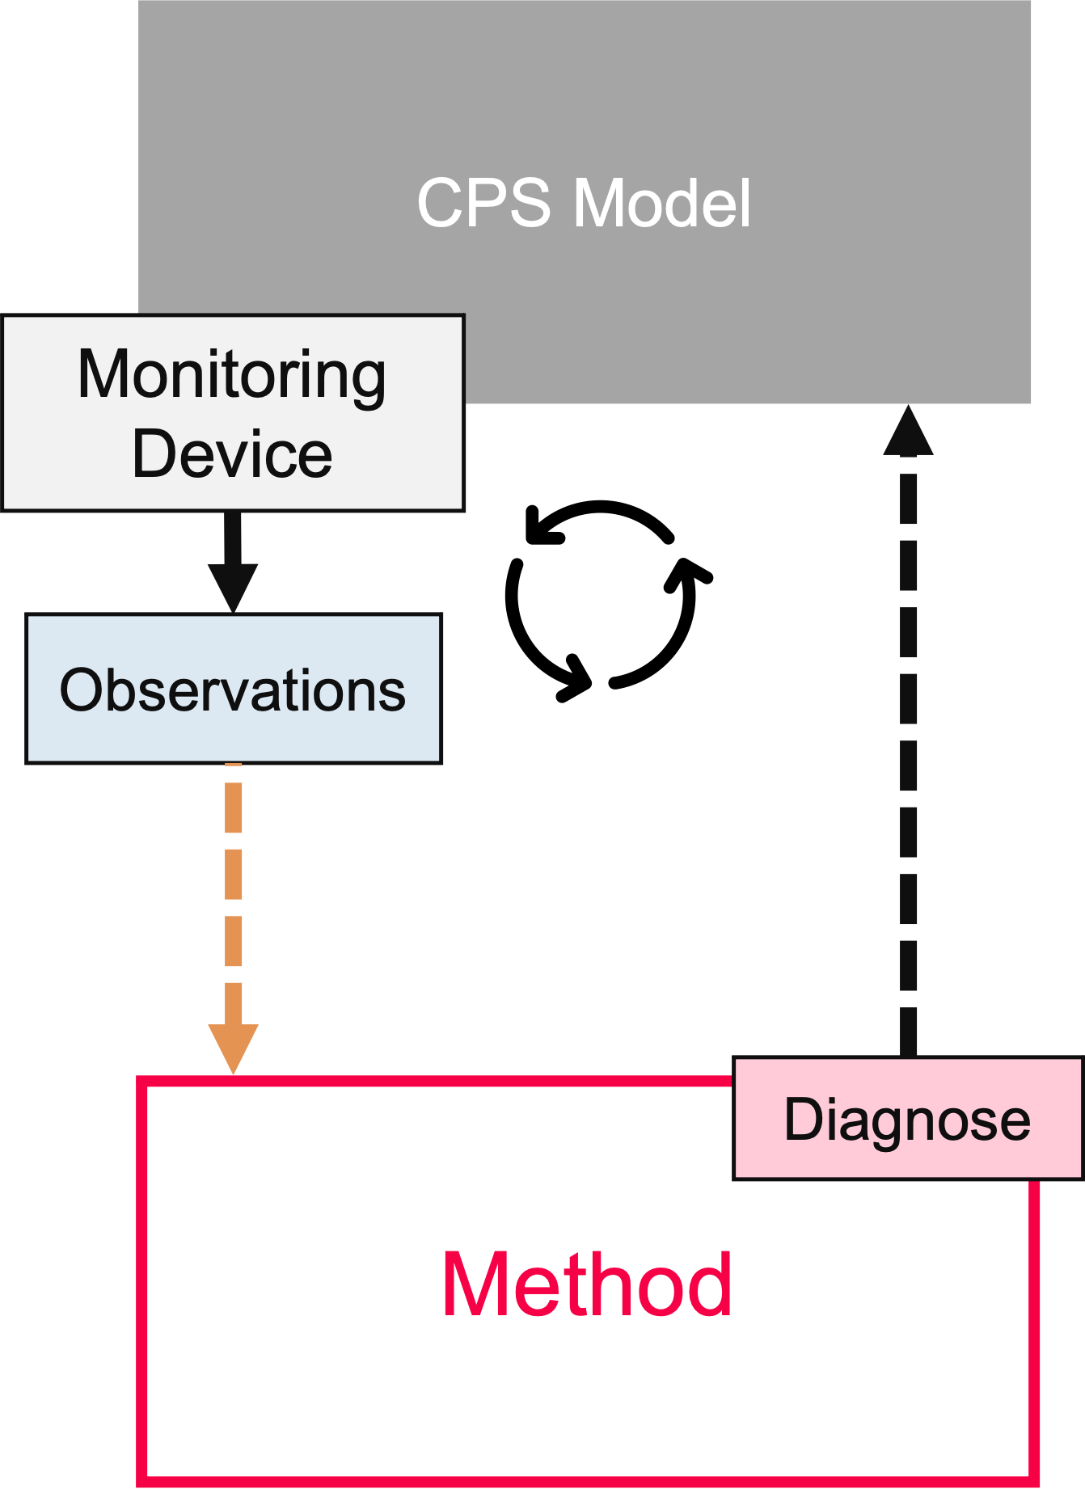
Framework Design and Method Implementation
Cyber-Physical-System (CPS) model
Monitoring for observations
Method under test, e.g.:
Model-based diagnosis
Simulation-based diagnosis
ML-based diagnosis
Fault detection & localization of root cause
Diagnose feedback for failure mitigation

Slide 7
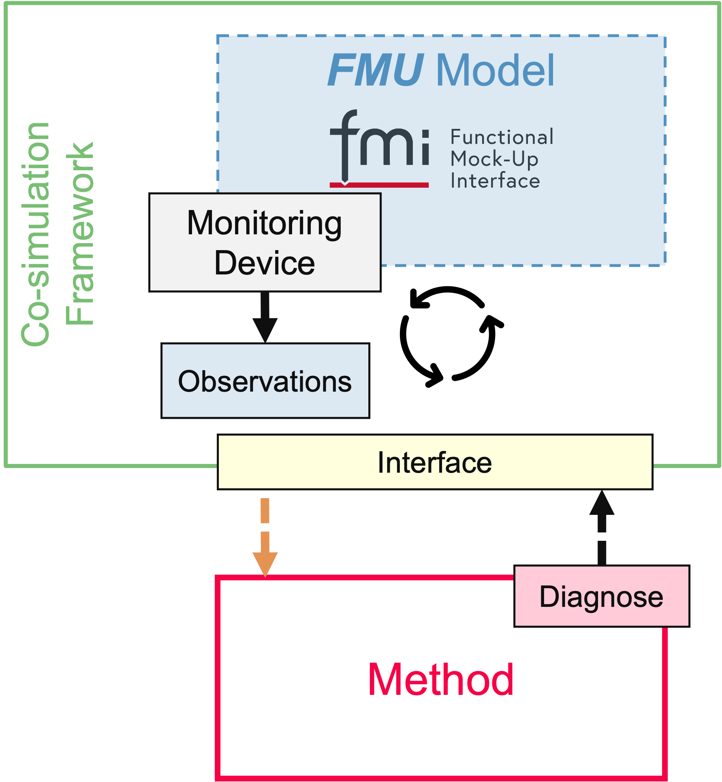
Framework Design and Method Implementation
Co-simulation framework
Use of standardized format FMU as models
Solver integrated in co-simulation FMU
Perform step-by-step simulation
Simple interface for linking tools
Different programming environments
Test & validation environment for tools

Slide 8
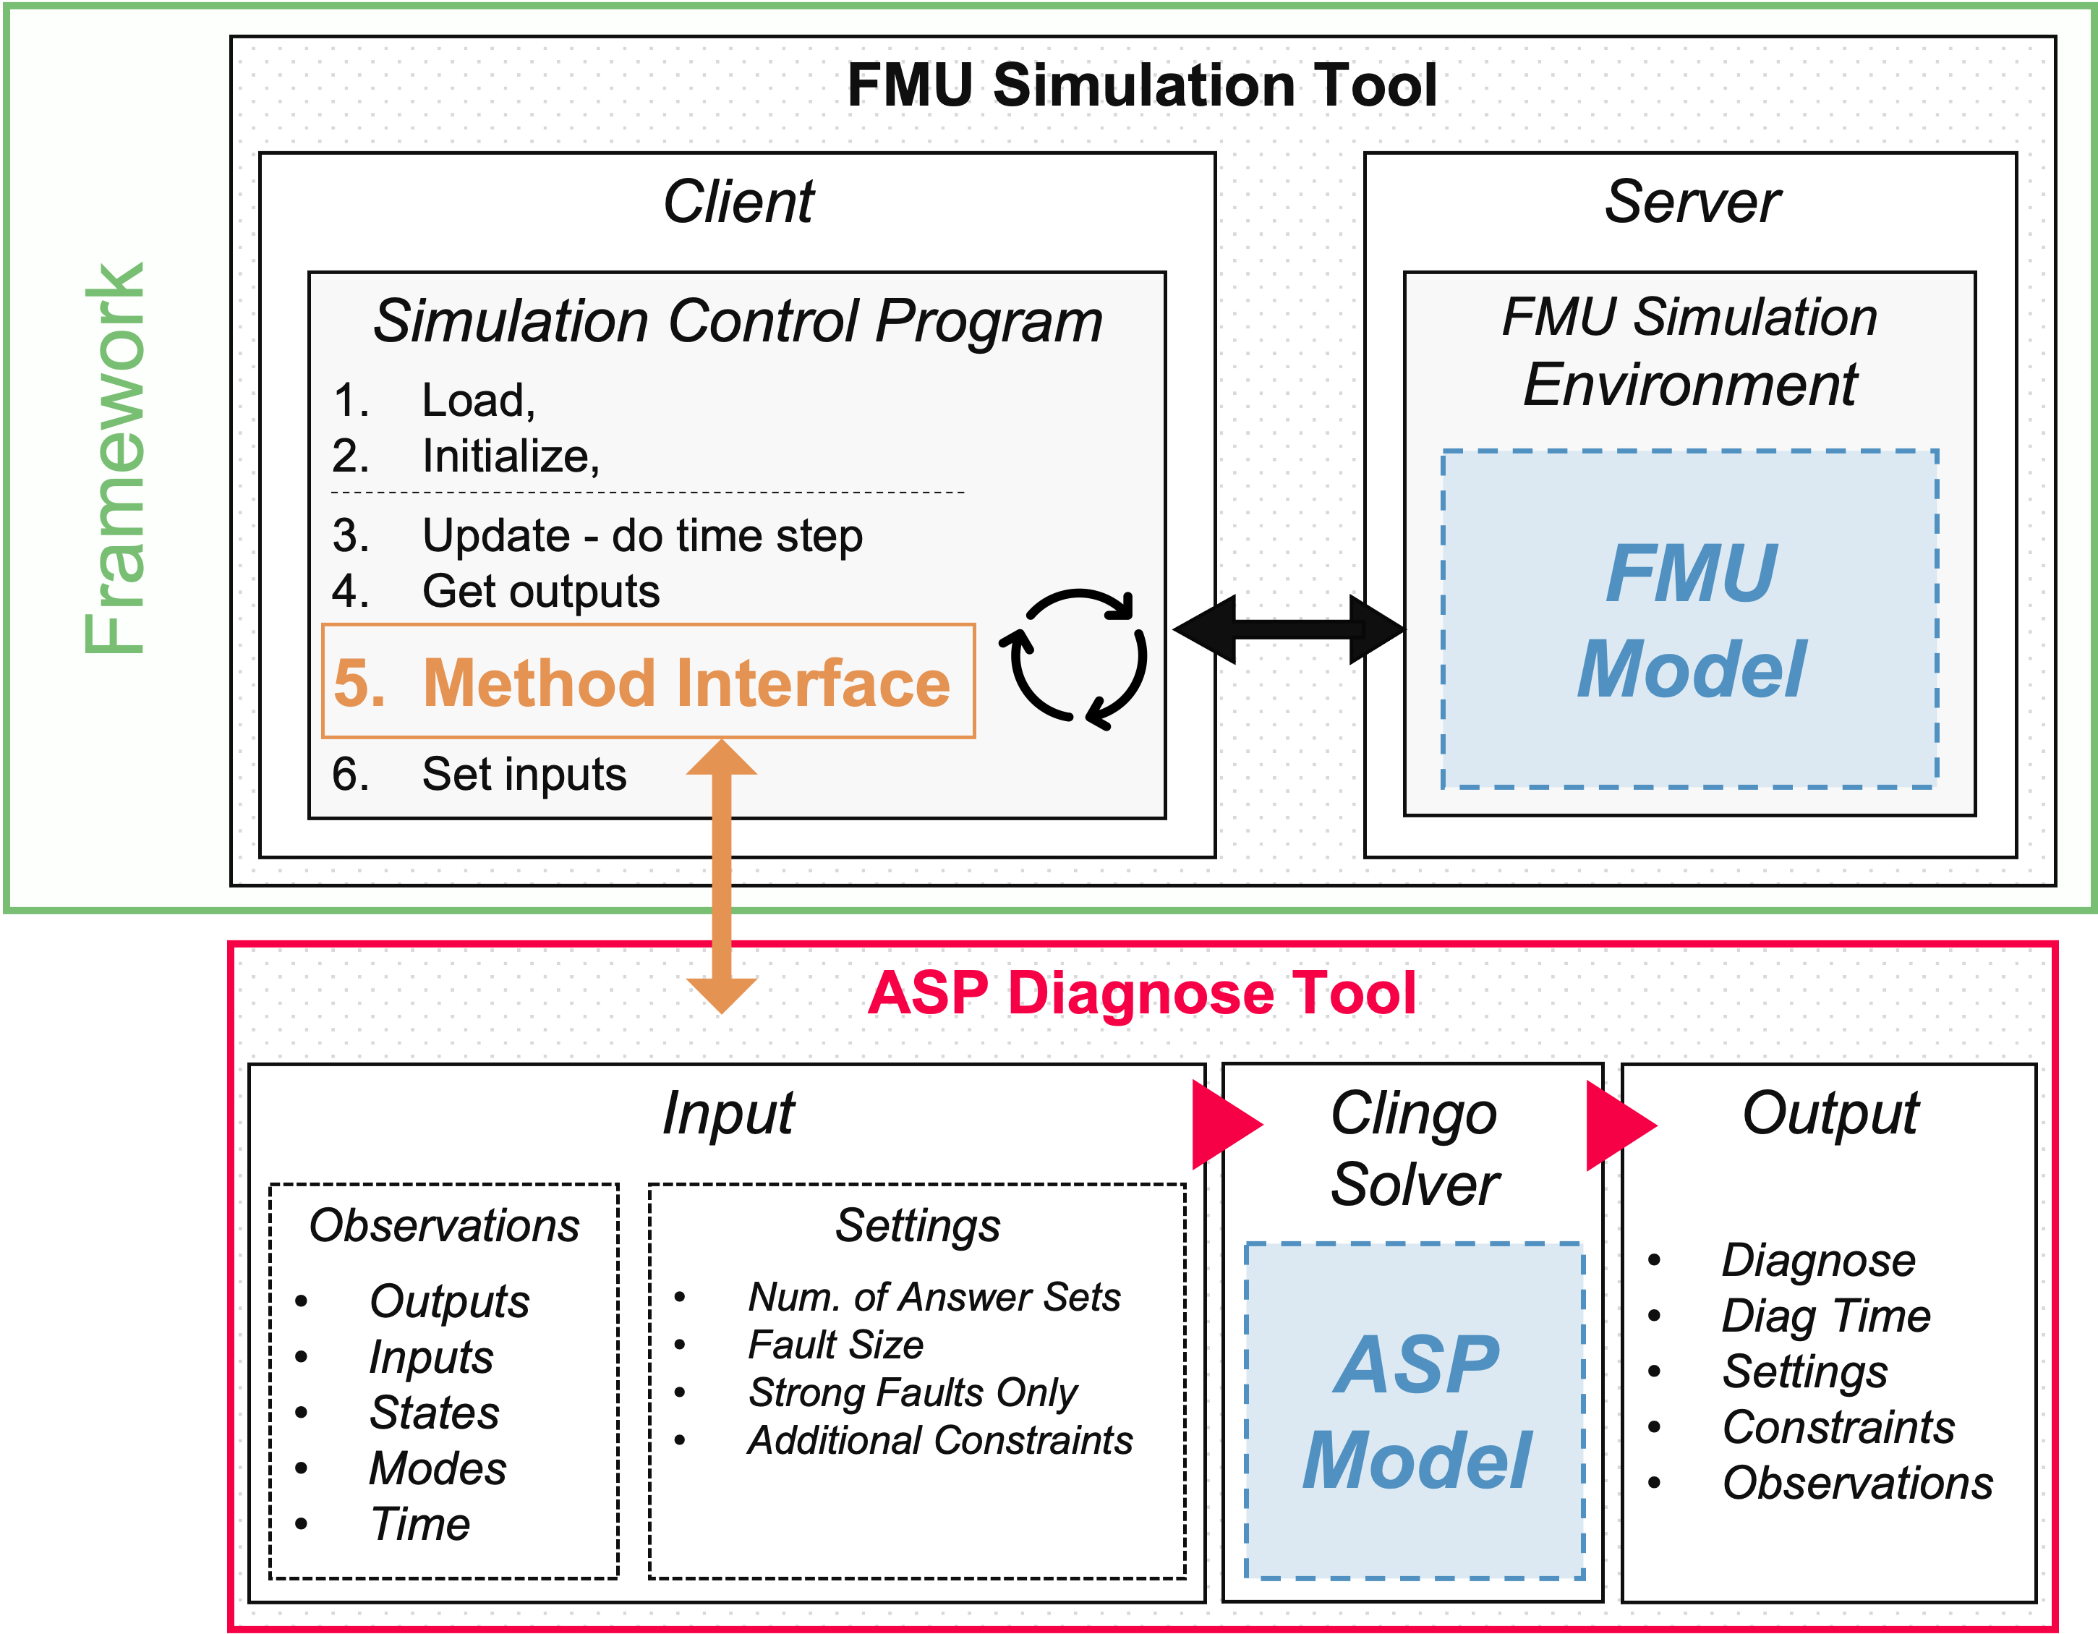



Framework Design and Method Implementation
Framework:
FMU Simulation Tool
Client-Server solution
Dockerized simulation environment
Multiple models in co-simulation
PyFMI library
REST API communication
Method:
ASP Diagnose Tool
Theorem solver Clingo 5.4.1
Input: observations & settings
Output format: JSON, CSV
Models:
FMU Model (generated from CPS)
ASP Model (abstract model of CPS)

Slide 9
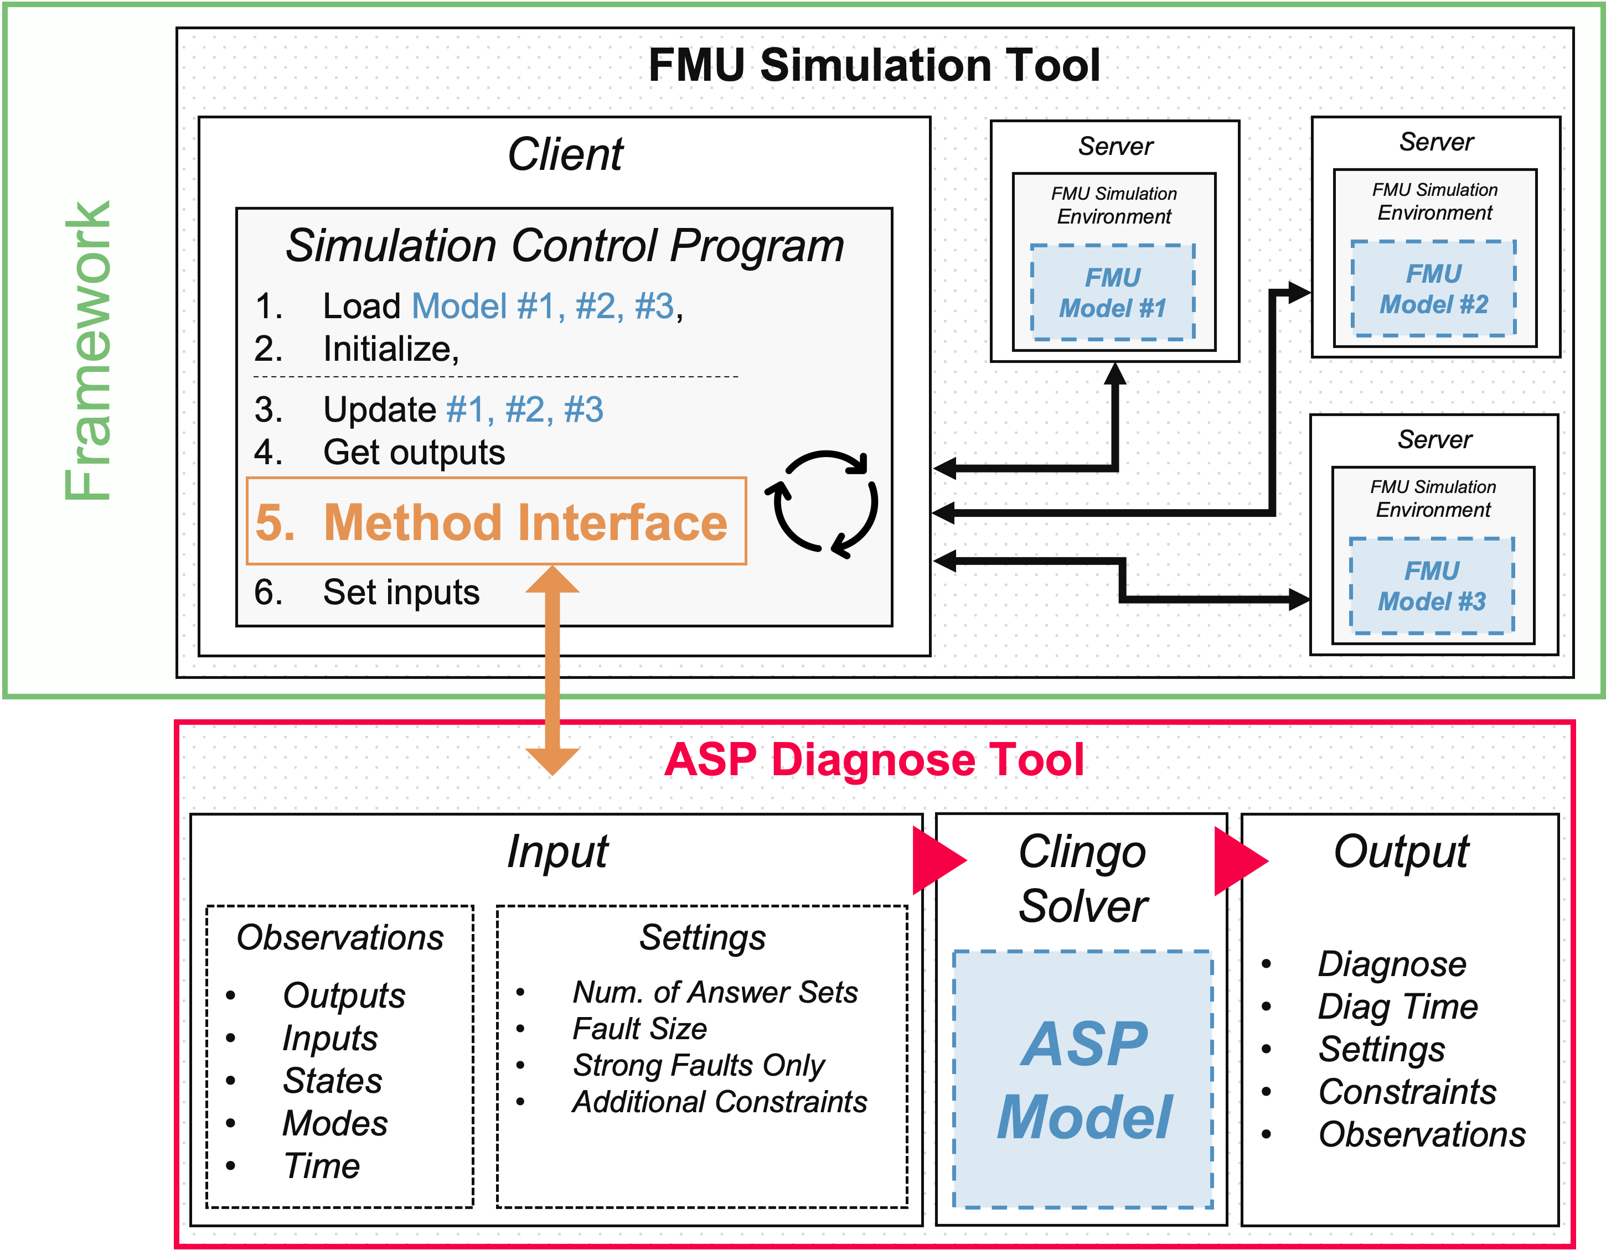
Framework Design and Method Implementation
Framework:
FMU Simulation Tool
Client-Server solution
Dockerized simulation environment
Multiple models in co-simulation
PyFMI library
REST API communication
Method:
ASP Diagnose Tool
Theorem solver Clingo 5.4.1
Input: observations & settings
Output format: JSON, CSV
Models:
FMU Model (generated from CPS)
ASP Model (abstract model of CPS)

Slide 10
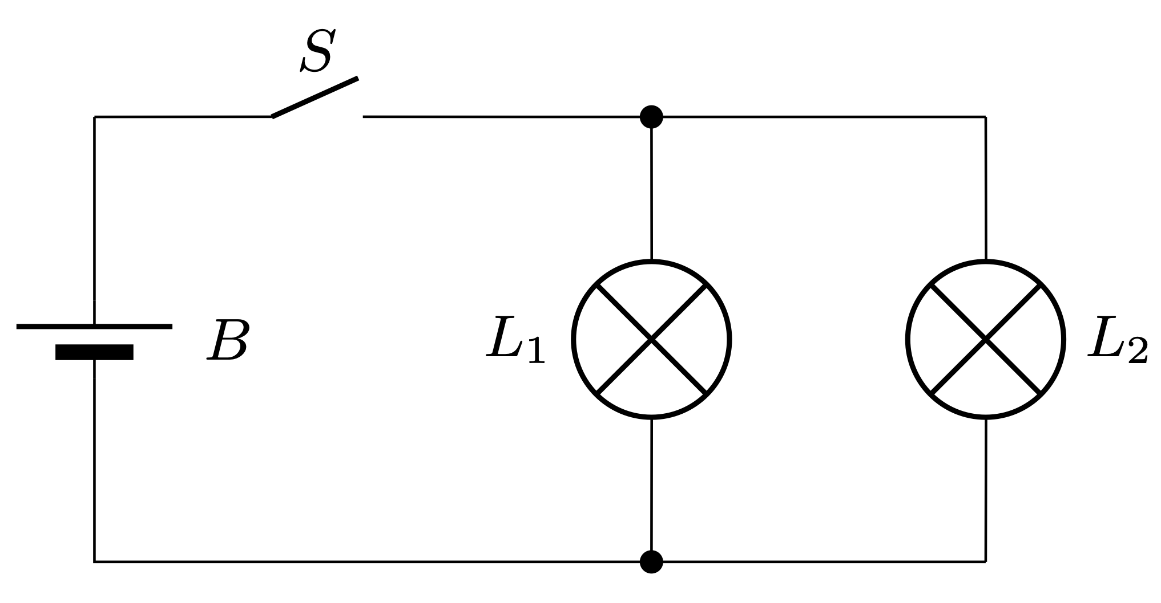
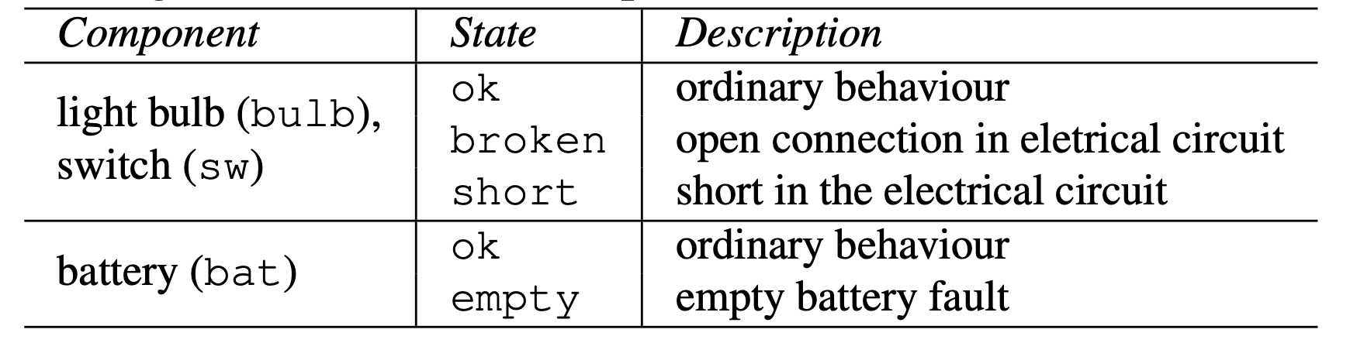
Use Case – CPS Simulation Model
model Two_Lamp_Circuit
PhysicalFaultModeling.PFM_Bulb bulb1(r = 100.0);
PhysicalFaultModeling.PFM_Bulb bulb2(r = 100.0);
PhysicalFaultModeling.PFM_Switch sw;
PhysicalFaultModeling.PFM_Ground gnd;
PhysicalFaultModeling.PFM_Battery bat(vn = 5.0);
equation
connect(gnd.p, bat.m);
connect(bat.p, sw.p);
connect(sw.m, bulb1.p);
connect(sw.m, bulb2.p);
connect(bulb1.m, gnd.p);
connect(bulb2.m, gnd.p);
end Two_Lamp_Circuit;
model Two_Lamp_Circuit_Testbench
PhysicalFaultModeling.Two_Lamp_Circuit sut;
input FaultType bat_state(start=FaultType.ok);
input OperationalMode switch_mode(start=OperationalMode.close);
input FaultType switch_state(start=FaultType.ok);
input FaultType bulb1_state(start=FaultType.ok);
input FaultType bulb2_state(start=FaultType.ok);
equation
sut.sw.mode = switch_mode;
sut.bat.state = bat_state;
sut.sw.state = switch_state;
sut.bulb1.state = bulb1_state;
sut.bulb2.state = bulb2_state;
end Two_Lamp_Circuit_Testbench;
OpenModelica OMEdit
Electrical circuit model
Components:
Battery
Switch
Lamp 1 & 2
Component fault types
FMU generation
circuit components & connections
define components state input

Slide 11
Use Case – ASP Diagnose Model
Answer Set Programming
Model behavior in first order logic representation
Components:
Battery
Switch
Lamp 1 & 2
Component connection
Lamp state (on, off) logic
val(light(X),on) :- type(X,lamp), val(in_pow(X),nominal), nab(X). val(in_pow(X),nominal) :- type(X,lamp), val(light(X),on). val(light(X),off) :- type(X,lamp), val(in_pow(X),zero), nab(X).
Component connection logic
val(X,V) :- conn(X,Y), val(Y,V). val(Y,V) :- conn(X,Y), val(X,V). :- val(X,V), val(X,W), not V=W.
type(b, bat). type(s, sw). type(l1, lamp). type(l2, lamp).
conn(in_pow(s), pow(b)). conn(out_pow(s), in_pow(l1)). conn(out_pow(s), in_pow(l2)).

Slide 12
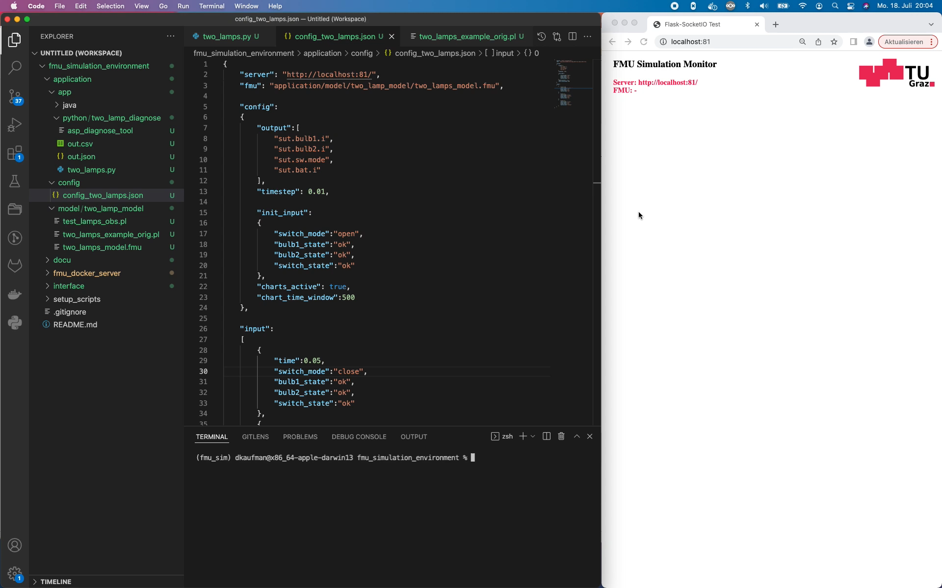
Use Case - Demonstration

Slide 13
Conclusion
Co-simulation framework for FMU models
Simulations are safe and cost efficient
Example method: ASP Diagnose Tool
Usability tested by students:
Simple setup
Fast and productive tool to gather results
Use Cases: Low-Pass-Filter, H-Bridge, Heater-Panel, Javelin-Throw, etc.
Projection in the future:
Test and validate diagnosis methods for AI systems
Test planning tools for mitigating
Simulation framework interface allows to add any method
Diagnosis is part of self adaptive system with growing interest in autonomous driving
Distribute co-simulation framework to the community

Slide 14

Thank You
For your attention
David.Kaufmann@ist.tugraz.at

Slide 15
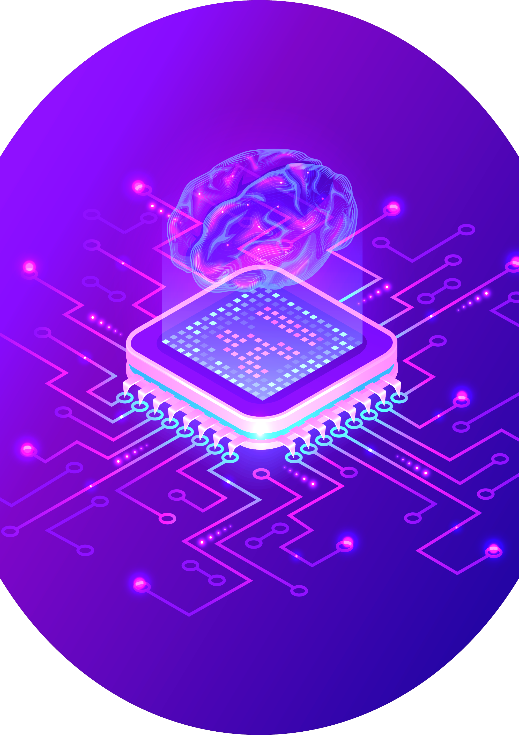



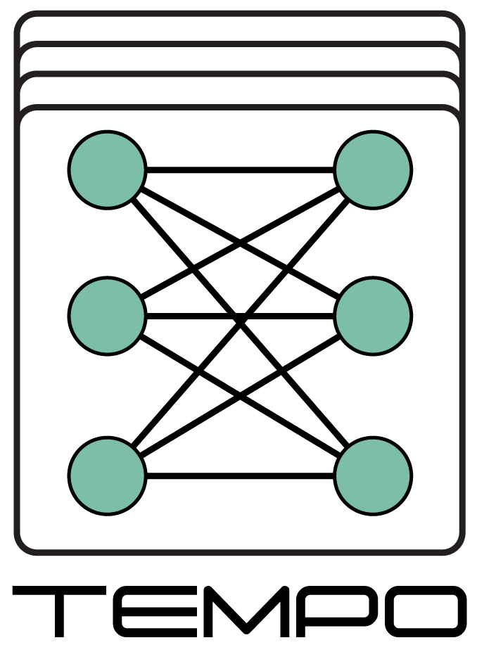

Event Organisers
The Key Digital Technologies Joint Undertaking - the Public-Private Partnership for research, development and innovation – funds projects for assuring world-class expertise in these key enabling technologies, essential for Europe's competitive leadership in the era of the digital economy. KDT JU is the successor to the ECSEL JU programme. www.kdt-ju.europa.eu
The AI4DI project has received funding from the ECSEL Joint Undertaking (JU) under grant agreement No 826060. The JU receives support from the European Union’s Horizon 2020 research and innovation programme and the national authorities. www.ai4di.eu
The TEMPO project has received funding from the ECSEL Joint Undertaking (JU) under grant agreement No 826655. The JU receives support from the European Union’s Horizon 2020 research and innovation programme and Belgium, France, Germany, The Netherlands, Switzerland. www.tempo-ecsel.eu
The ANDANTE project has received funding from the ECSEL Joint Undertaking (JU) under grant agreement No 876925. The JU receives support from the European Union’s Horizon 2020 research and innovation programme and Belgium, France, Germany, The Netherlands, Portugal, Spain, Switzerland. www.andante-ai.eu

